Slide 1

Amended Rules and Procedures for Unclaimed and Unidentified IOLTA Funds
Dorothy Anderson, Office of Bar Counsel
Jenna Miara, Massachusetts IOLTA Committee
September 5, 2024

Slide 2
What is the Purpose of the Amendments to Rule 1.15?
To encourage Massachusetts lawyers to identify and remit unclaimed and unidentified IOLTA funds to the owners of those funds.
To transfer funds that cannot, after diligent efforts, be returned to the owners of such funds, to the important organizations and for the uses set out in Mass. R. Prof. C. 1.15(g)(4).
The IOLTA Committee distributes funds to three charities: Massachusetts Legal Assistance Corporation (67%); Massachusetts Bar Foundation (26%); and Boston Bar Foundation (7%). These charities use IOLTA funds to make grants to programs and projects that provide civil legal help to Massachusetts residents who cannot afford a lawyer and initiatives that improve the administration of justice.

Slide 3
The New Provisions of Mass. Rule P. Conduct 1.15
The new rules and comments are found at:
    Mass. R. Prof. C. 1.15(h)(5) through (9)
    Mass. R. Prof. C. 1.15 (i)
    Mass. R. Prof. C. 1.15, comments 15- 18
    Mass. R. Prof. C. 1.15A (e)(4)

Slide 4
Inactive IOLTA Accounts
Rule 1.15(h): New Rules Concerning inactive IOLTA Accounts
Lawyers can only maintain an IOLTA account at a financial institution that agrees to report account inactivity to the Board of Bar Overseers (Board). Rule 1.15(h)(1)
If there is no activity (no transactions other than accrual and disbursement of interest) in an IOLTA account for two and one-half years, financial institution to inform lawyer that it will notify Board if inactivity continues for six more months. Rule 1.15(h)(5)(i)
After three years of inactivity, financial institution must notify the Board, with copies to lawyer and law firm at which lawyer last practiced. Rule 1.15(h)(5)(ii)
On receiving a three-year inactivity notice, lawyer must:
  (a) Close the account and distribute the funds to owners (if known) or to IOLTA Committee, and notify the Board of the action taken; or
  (b) If funds are in the account for a valid reason and the account should remain open, explain to Board and financial institution.
If lawyer takes no action for one year following issuance of the three-year inactivity notice, financial institution must distribute the funds to IOLTA Committee and close the account. Rule 1.15(h)(7).

Slide 5
Duty to Dispose of Unclaimed and Unidentified Funds
Rule 1.15(i) creates new duties for lawyers holding unclaimed and unidentified funds in an IOLTA account:
    Discovery of unclaimed and/or unidentified funds in IOLTA triggers duty to act.
    Lawyers must promptly make reasonable and diligent efforts to identify and locate owners of funds. (Mass. R. Prof. C. 1.15(i)(1))
    After completing such efforts, lawyers may remit funds to IOLTA Committee at any time. (Mass. R. Prof. C. 1.15(i)(2))
    Three years after discovery of unclaimed or unidentified IOLTA funds, lawyers must remit funds to IOLTA Committee. (Mass. R. Prof. C. 1.15(i)(3))

Slide 6
Remitting Funds to IOLTA Committee
To remit funds to the IOLTA Committee, a lawyer must complete an online affidavit and make an electronic transfer of funds. The affidavits and further instructions are available on the IOLTA Committee website: Undistributable IOLTA Funds (maiolta.org)
There are two affidavits:
  Safe Harbor Affidavit: Remitting $500 or less to the IOLTA Committee within a 12-month period.
  Over $500 Affidavit: Remitting more than $500 within a 12-month period.
Affidavits are account-specific.
A copy of all Over $500 Affidavits will be automatically provided to the Board.
After submitting an affidavit, a lawyer must respond to any request from the Board for further information about the lawyer’s effort to identify and locate the owner of the funds transmitted and cooperate with any investigation.

Slide 7
Tips for submitting affidavit and payment
Progress cannot be saved. Before starting the affidavit:
  Review Rule 1.15, the Attorney Undistributable FAQs and blog on the IOLTA Committee’s website, and the IOLTA Committee Instructions for the remittance portal.
  Have the attorney’s BBO number and information about the IOLTA account involved handy.
  Know the approximate date you discovered the funds were unclaimed and unidentified.
  Assemble the information and supporting documents regarding the funds and efforts to identify the owner of the funds or to locate the owner and remit the funds.
When making the electronic transfer, double check your IOLTA account number before submitting the payment.
Keep copies of the confirmation email you receive with an invoice number for the affidavit and the payment receipt. You can also download a copy of the affidavit.

Slide 8
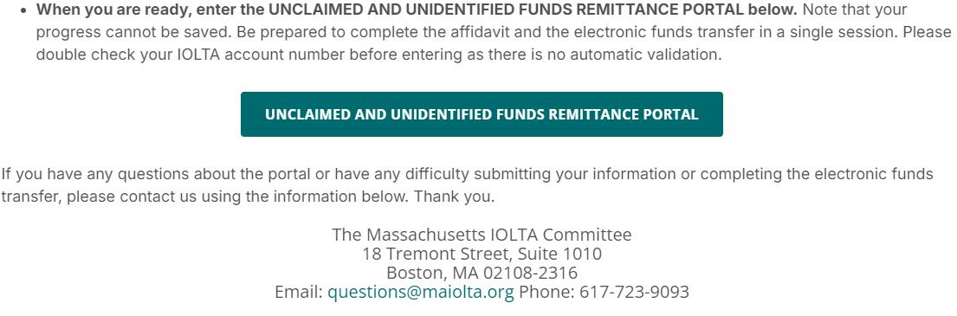
Submitting online affidavit
Webpage: https://www.maiolta.org/for-attorneys/undistributable-iolta-funds
Scroll to bottom of the page and click here:

Slide 9
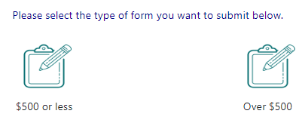
Submitting online affidavit
Enter email and generate email to you with a One-Time Password (OTP). If password not received, check your spam/junk mail folders or your email quarantine.
Enter OTP.
Select $500 or Less (“Safe Harbor”) or Over $500 Affidavit.

Slide 10
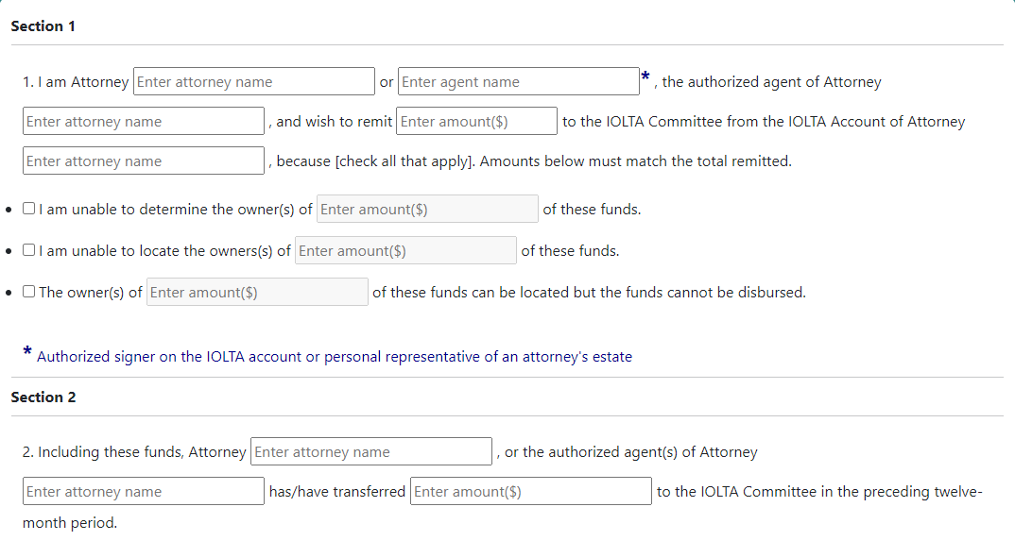




Safe harbor affidavit
Must match type of Affidavit selected

Slide 11
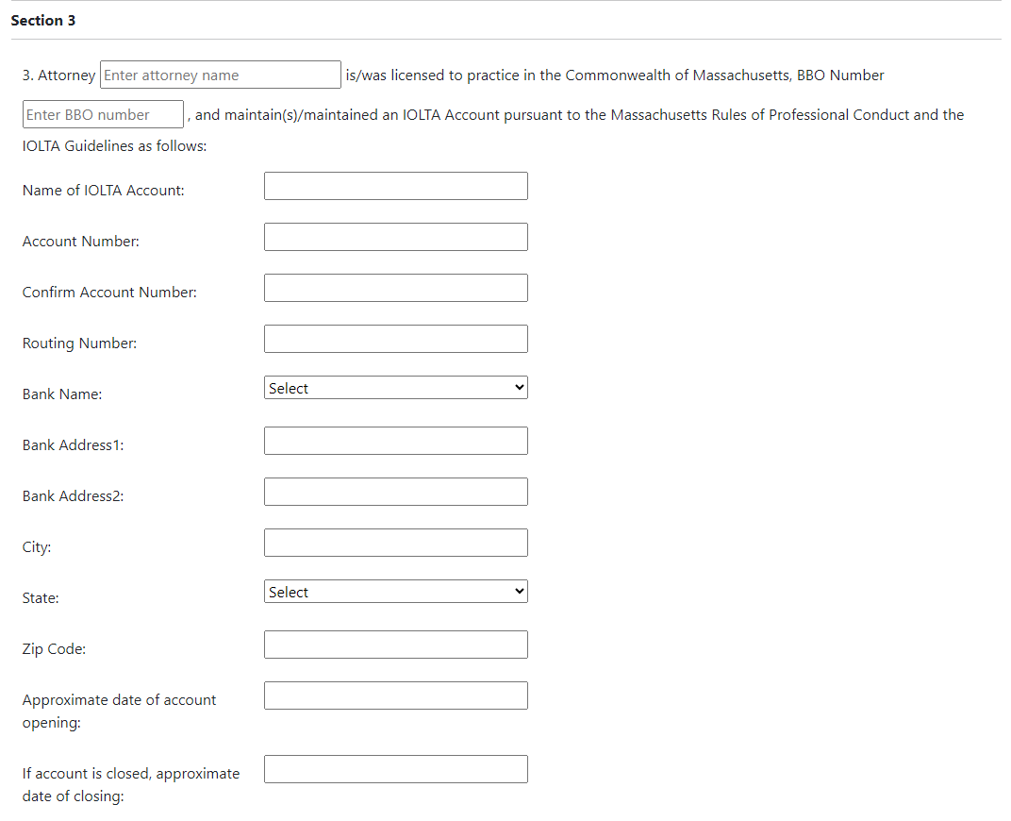

Slide 12
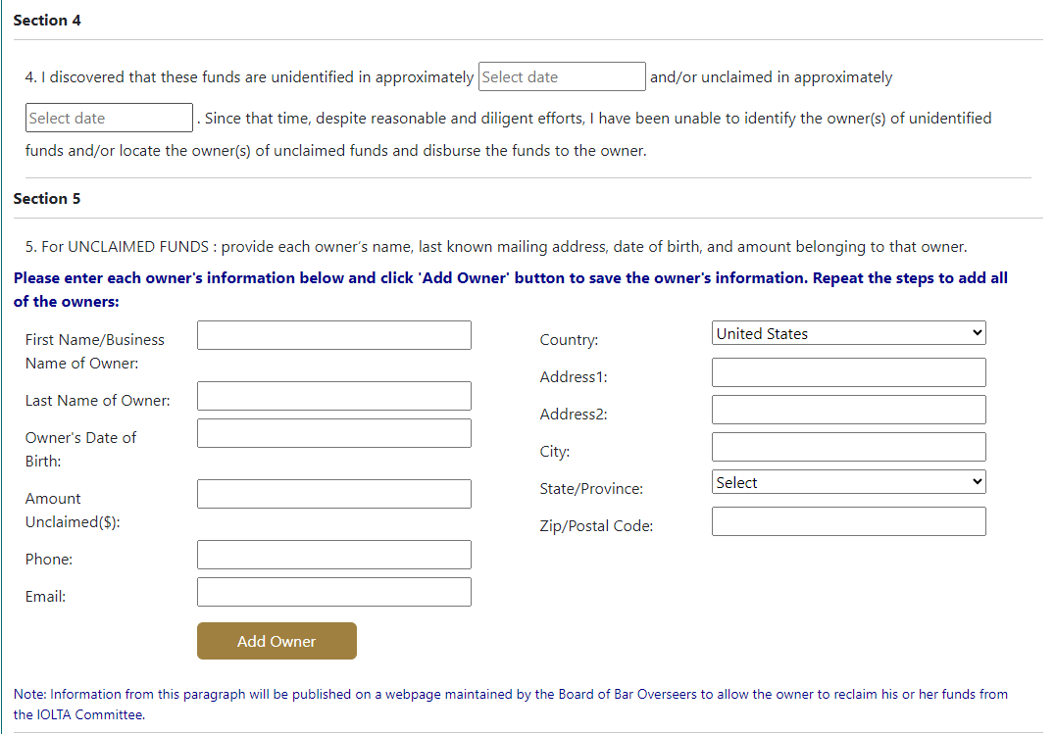
Click to add 1st owner, can enter additional owners if needed

Slide 13
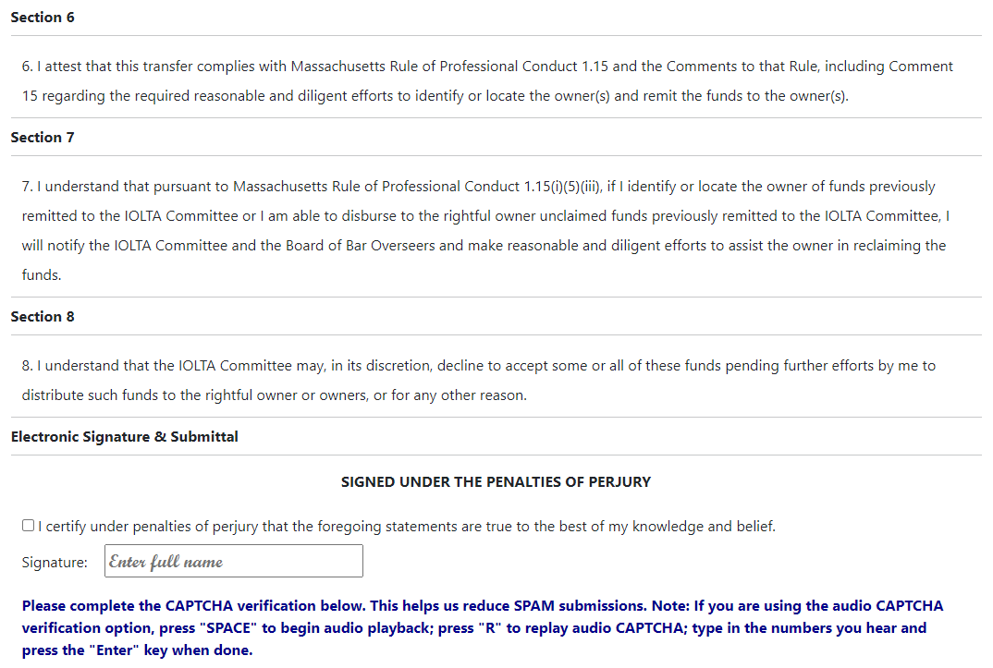

Slide 14
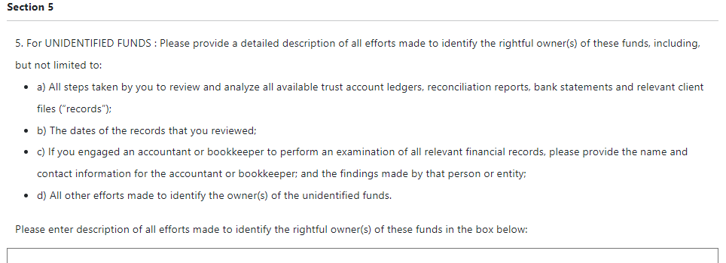
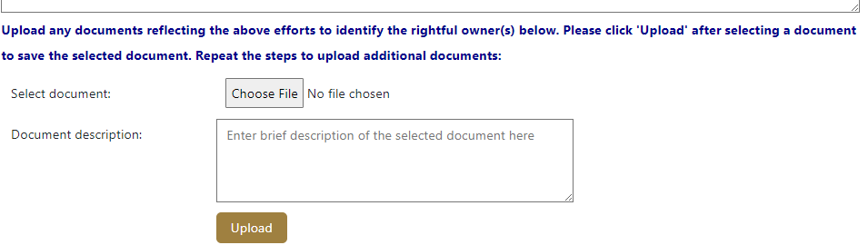
Over $500 affidavit

Slide 15
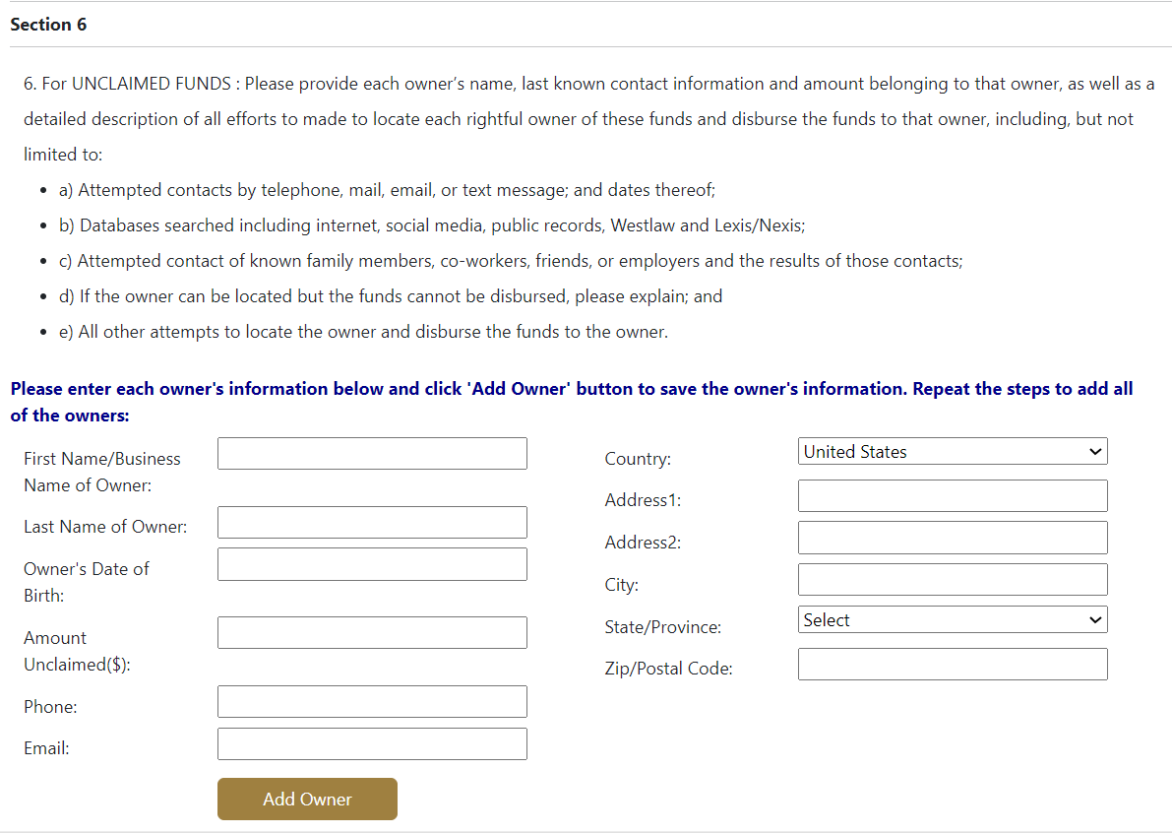
Over $500 affidavit

Slide 16
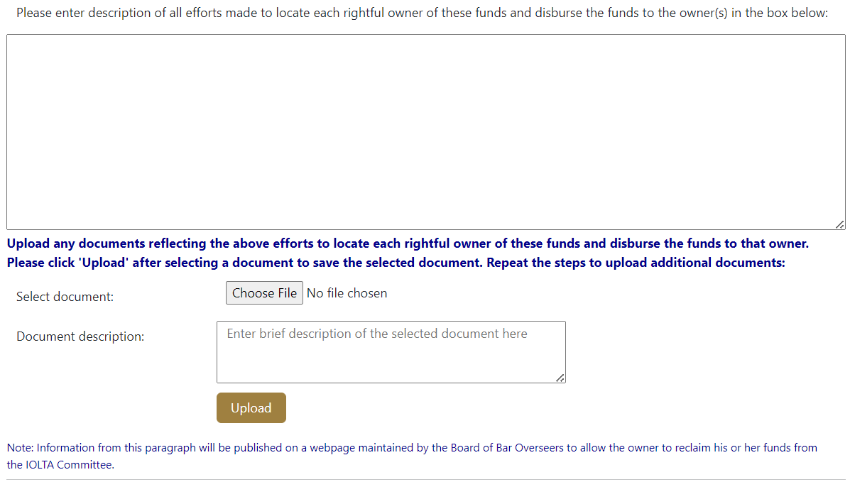
Over $500 affidavit

Slide 17
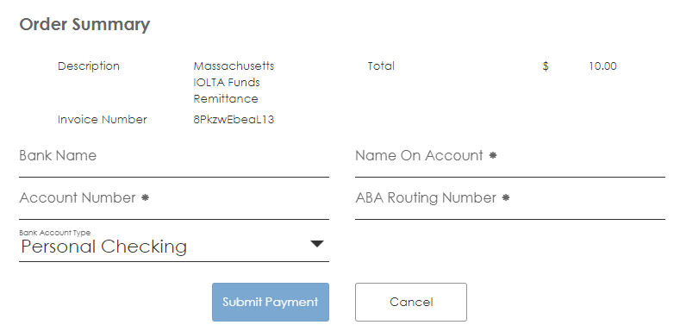
Payment portal
Confirm Account No.
Select Business Checking

Slide 18
Returning Funds to Owners
  The Board has published on its website and will continue to update a list of the owners of unclaimed funds, along with the last known zip code of the owner, and the amount held by the IOLTA Committee Unclaimed IOLTA Funds - List (massbbo.org).
  If an owner finds their name on the list, the lawyer who transmitted the owner’s funds to the IOLTA Committee may be asked and shall comply with any requests from the Board to verify the owner’s claims to the fund.
  If a lawyer transmits funds to the IOLTA Committee, and later identifies and/or locates the owner of those funds, the lawyer must notify the IOLTA Committee and the Board and assist in efforts to return those funds to the owner.
    Lawyers must maintain files potentially related to unclaimed or unidentified funds transferred to the IOLTA Committee for at least 10 years. Mass. R. Prof. C. 1.15A (e)(4).

Slide 19
Tips for Lawyers (unclaimed funds)
Review your IOLTA accounts NOW for unclaimed funds.
Make list of all checks that remain unnegotiated after 90 days.
Attempt to determine why payee has not negotiated check.
If checks were returned in the mail as “undeliverable”, use internet and other means to search for better addresses for payees.
Stop checks and reissue them as appropriate.
Retain records of all attempts to remit funds to payee.
See Comment 15 to Mass. R. Prof. C. 1.15 for discussion of reasonable efforts.
See Christine Deshler, “What To Do When A Client Goes Missing”, September 2020 (BBO Webpage/resources/Article on Ethics), re locating missing clients.

Slide 20
Tips for Lawyers (unidentified funds)
Do your three-way reconciliation of IOLTA check register, client ledgers and bank statement balance NOW.
Determine if you are holding unidentified funds in your IOLTA account.
Attempt to determine how long you have been holding the unidentified funds.
Review your check register and client ledgers for any errors and correct them.
Discuss the unidentified amounts with all attorneys and staff who have access to the account.
If you are holding a significant amount of unidentified funds, consider hiring a bookkeeper or accountant to perform a forensic review.
If you took over an IOLTA account that already held unidentified funds, contact former account signatories for information about those funds.

Slide 21

FREQUENTLY ASKED QUESTIONS
Q. When a lawyer’s Over $500 Affidavit has been sent to the Board, what will the Board do with it?
  A. The Board will direct it to Bar Counsel, who will review the Affidavit to determine if the lawyer has made diligent efforts to identify and locate the owner of the funds or has engaged in a violation of Rule 1.15 meriting discipline.
Q. What are the usual sanctions for those violations?
  A. Where evidence indicates that the lawyer failed to engage in proper IOLTA record-keeping, failed to promptly deliver funds belonging to a client or third person, or engaged in another violation of Mass. R. Prof. C. 1.15, the most frequent sanctions have been private admonitions and public reprimands.
Q. What does “meriting discipline” mean?
  A. Bar counsel does not prosecute every violation of the rules it discovers. When minor misconduct, causing no harm to a client is discovered, bar counsel may close the file without discipline, or propose a diversion agreement with a lawyer.

Slide 22
FREQUENTLY ASKED QUESTIONS
Q. Who is an “authorized agent” who may submit an affidavit to transfer undistributable funds to the IOLTA Committee?
  A. In general, the affidavit should be completed by an attorney who is an authorized signatory on the IOLTA account. If such an attorney cannot complete the affidavit, it can be completed by an “authorized agent,” e.g. the personal representative of a deceased attorney. In certain circumstances, an authorized signatory on the IOLTA account who is not an attorney, such as a firm office manager or bookkeeper, may be an appropriate authorized agent. If an authorized signatory on the IOLTA account who is not an attorney or an attorney who is not an authorized signatory submits an Over $500 Affidavit, the affidavit should explain why.
Q. How is the three-year deadline under Rule 1.15(i)(3) to transfer undistributable funds to the IOLTA Committee calculated?
  A. It is calculated from when the funds are discovered to be unclaimed or undistributable. For undistributable funds discovered prior to the effective date of the amendments, it is calculated from 9/1/24, although lawyers should make prompt efforts to return funds to their owner.
Q. What should a lawyer do if they receive a notice from their bank or credit union of an inactive IOLTA account?
  A. The lawyer should review the notice carefully, and within six months, either disburse the funds and close the account if it is no longer needed, or follow the financial institution’s instructions for reactivating the account.

Slide 23
Contact us
Massachusetts IOLTA Committee – www.maiolta.org
  Questions@maiolta.org or call 617-723-9093
  Jenna Miara, Executive Director: jmiara@maiolta.org
Office of Bar Counsel – www.massbbo.org
  IOLTAfunds@massbbo.org or call 617-728-8750
  Janet Mueller, Trust Account Investigator: j.mueller@massbbo.org

